Slide 1
ZENER DIODES

Slide 2
Breakdown Voltage Ez or peak reverse voltage
Zener region-above breakdown voltage
Ez determined by resistivity of diode, which is controlled by doping
Rated breakdown voltage at Zener test current
Ez rated with 1 to 20% tolerance
Ability for zener diode for P diss decreases as temp increases
P diss rating for specific temp
Also based on lead length
Derating factor
6 mW / °C
Low power zener diode
High power zener diode

Slide 3
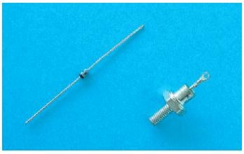
Zener Diode Characteristics (cont’d.)
Figure 21-1. Zener diode packages.

Slide 4
Zener Diode Characteristics (cont’d.)
Figure 21-2. Schematic symbol for a zener diode.

Slide 5
Zener Diode Ratings
Maximum Zener Current
--without exceeding pdiss ratings specified by manufacturer
Reverse current= leakage current, before breakdown.
Zener Voltage Temperature coefficient
Temperature compensated Zener Diode
More than one PN junction diode for proper temperature compensation

Slide 6
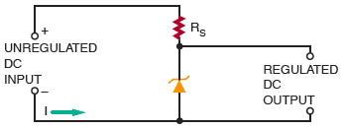
Voltage Regulation with Zener Diodes
Figure 21-3. Typical zener diode regulator circuit.
Zener voltage ratings
Voltage drop across the resistor
Change in input voltage appears across series resistor

Slide 7
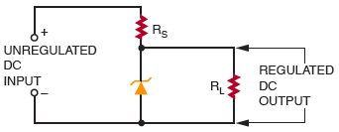
Voltage Regulation with Zener Diodes (cont’d.)
Figure 21-4. Zener diode voltage regulator with load.

Slide 8
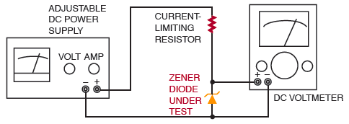
Testing Zener Diodes
Figure 21-5. Setup for testing zener diode regulation test.

